Slide 1
BUSINESS PROBLEM
The objective is to understand the underlying structure in your dataset and come up with a suitable forecasting model which can effectively forecast gold prices for next 30 days.

Slide 2
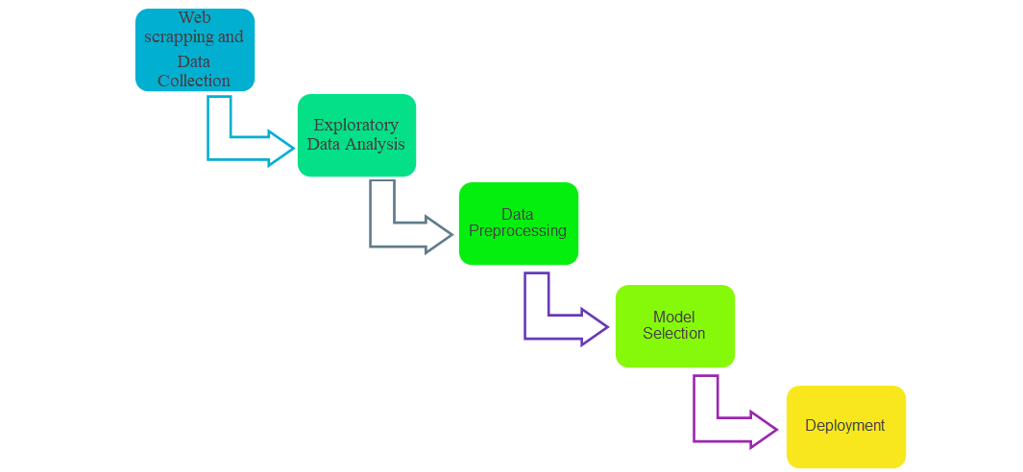
PROJECT ARCHITECHER/PROJECT FLOW

Slide 3
DATA SET DETAILS
The data set provides the price of the gold on that specific date.
Shape of the data :(13908, 2)
No. Of columns:2
No. Of rows:13908
ATTRIBUTE INFORMATION
Observation date : Date of the gold price variation
GOLDAMGBD228NLBM : Price of the gold

Slide 4
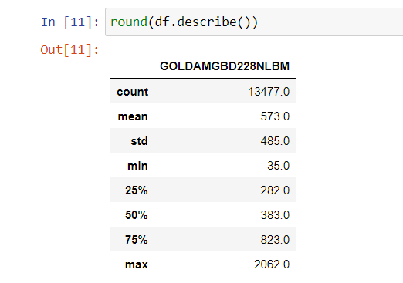
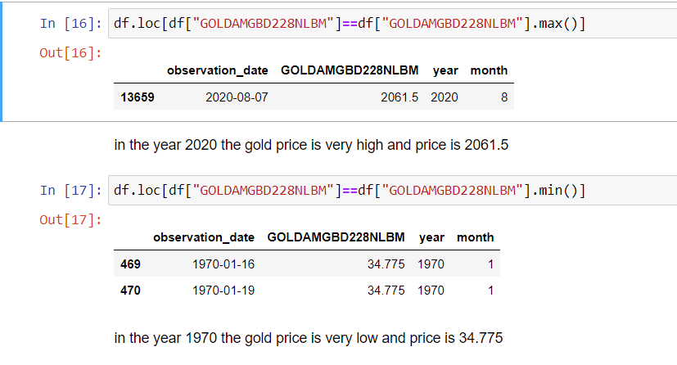
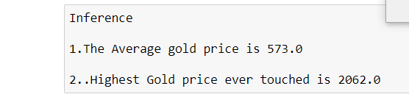
EXPLORATORY DATA ANALYSIS

Slide 5
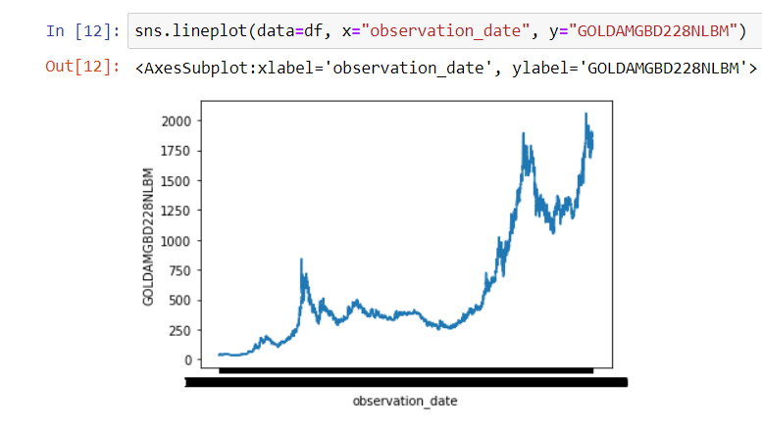
EXPLORATORY DATA ANALYSIS
In the line plot as the year increasing price of gold also increasing.

Slide 6
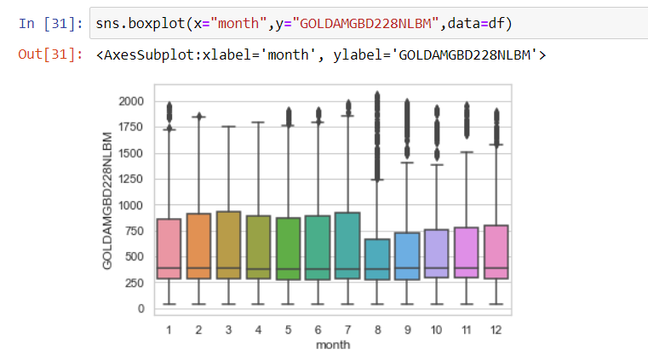

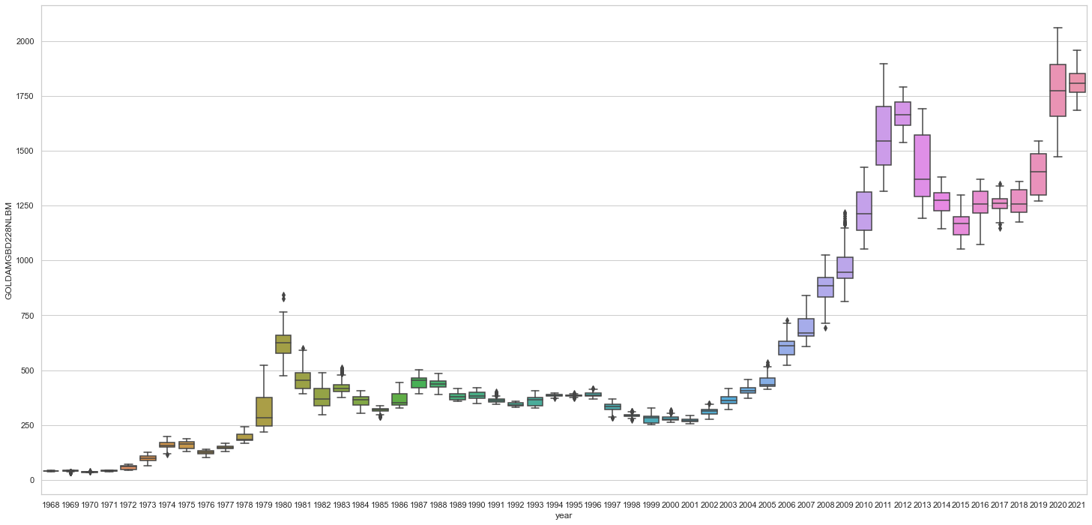
BOX PLOT ON YEAR WISE 1. BOXPLOT IS POSITIVELY SKEWED AND PRICE ALSO HIGH

Slide 7
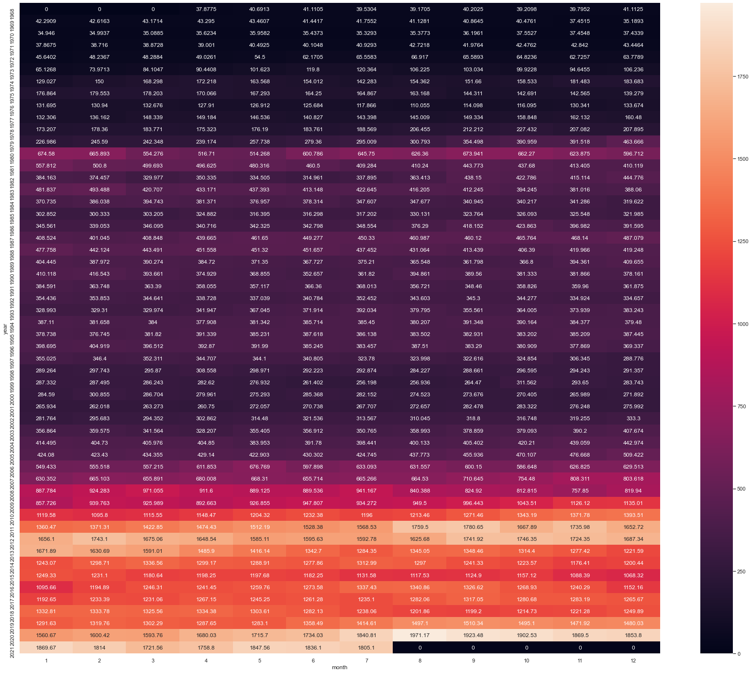
HEAT MAP FOR THE GOLD PRICE

Slide 8
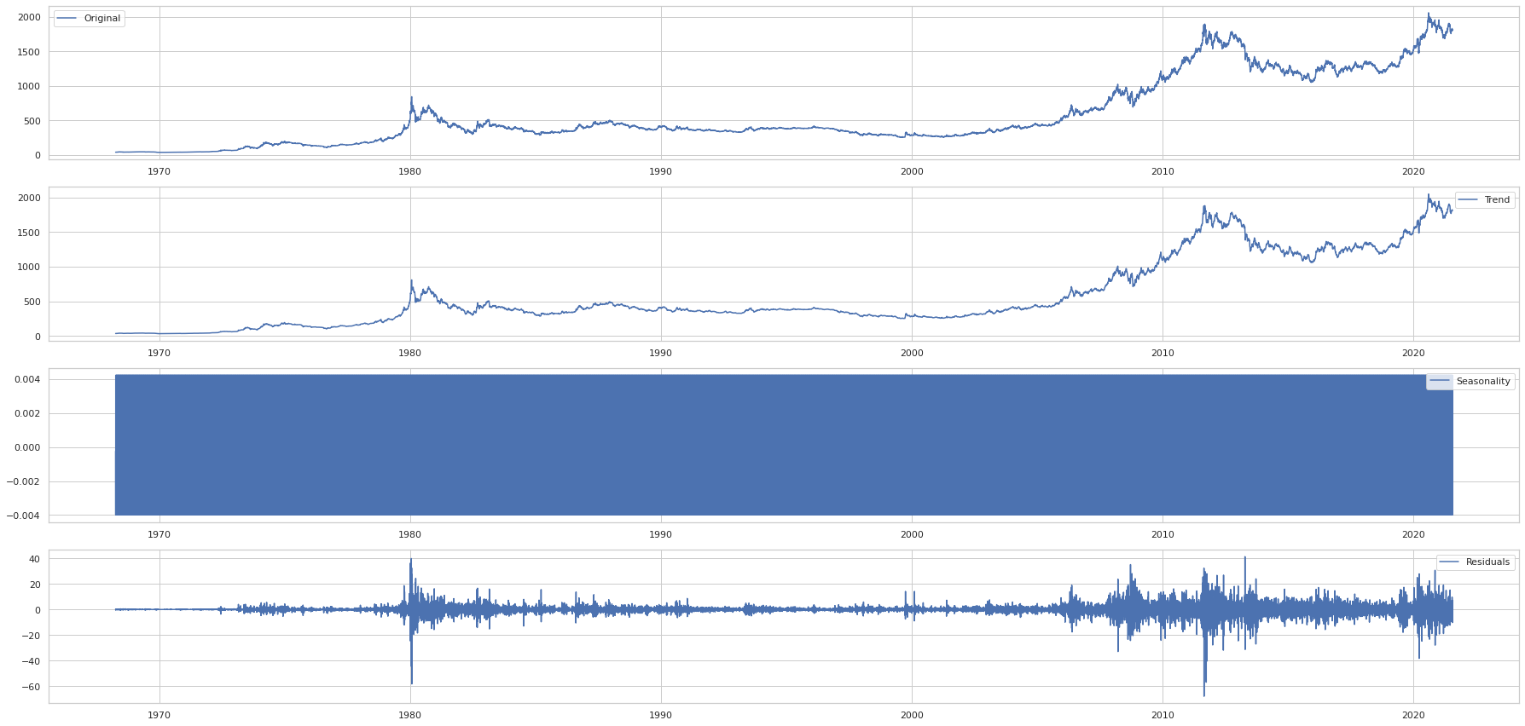
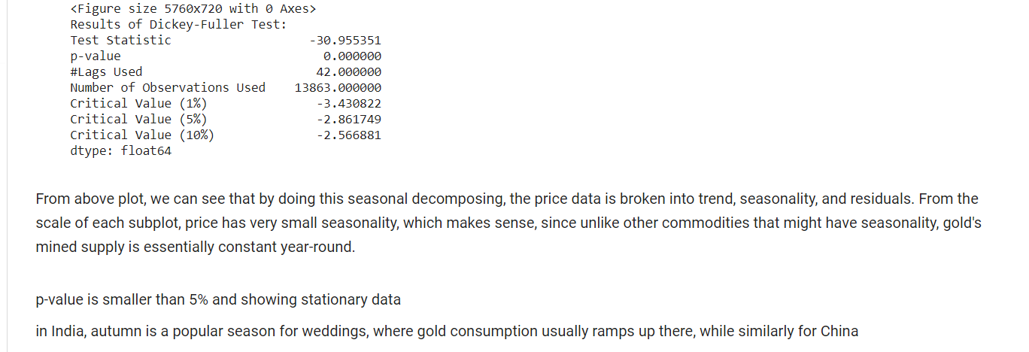
Decomposing plots for trend,seasonal,residual

Slide 9
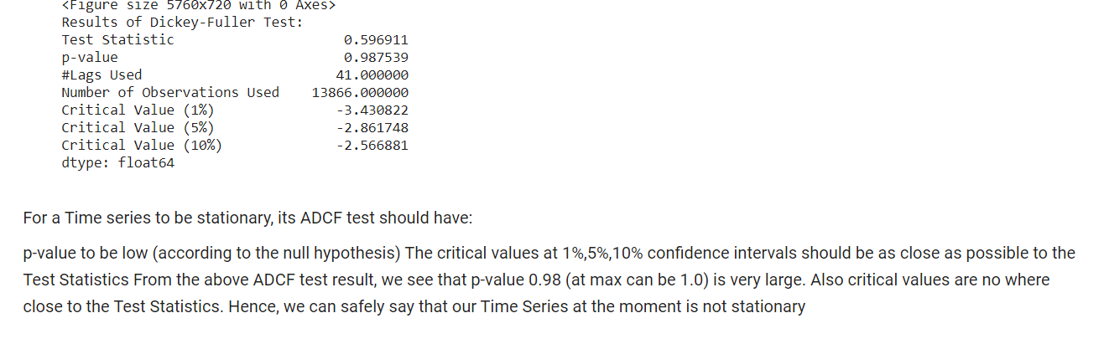
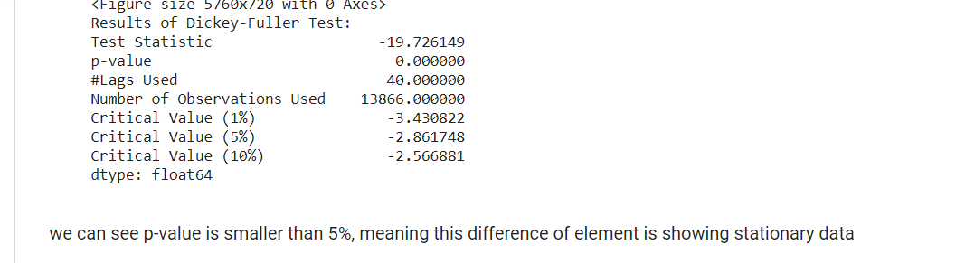
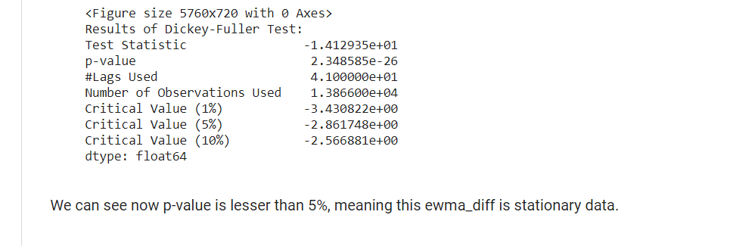
DATA STATIONARY TRANSFORMATION
STATIONARY CHECK FOR DATA SET USING DICKEY-FULLER TEST
By Differencing
By Exponential average

Slide 10
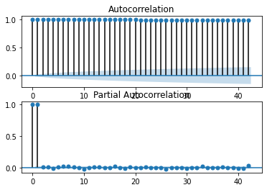
ACF AND PACF PLOTS
Graphically summarize the strength of relationship with an observation in time series with observation prior time step

Slide 11
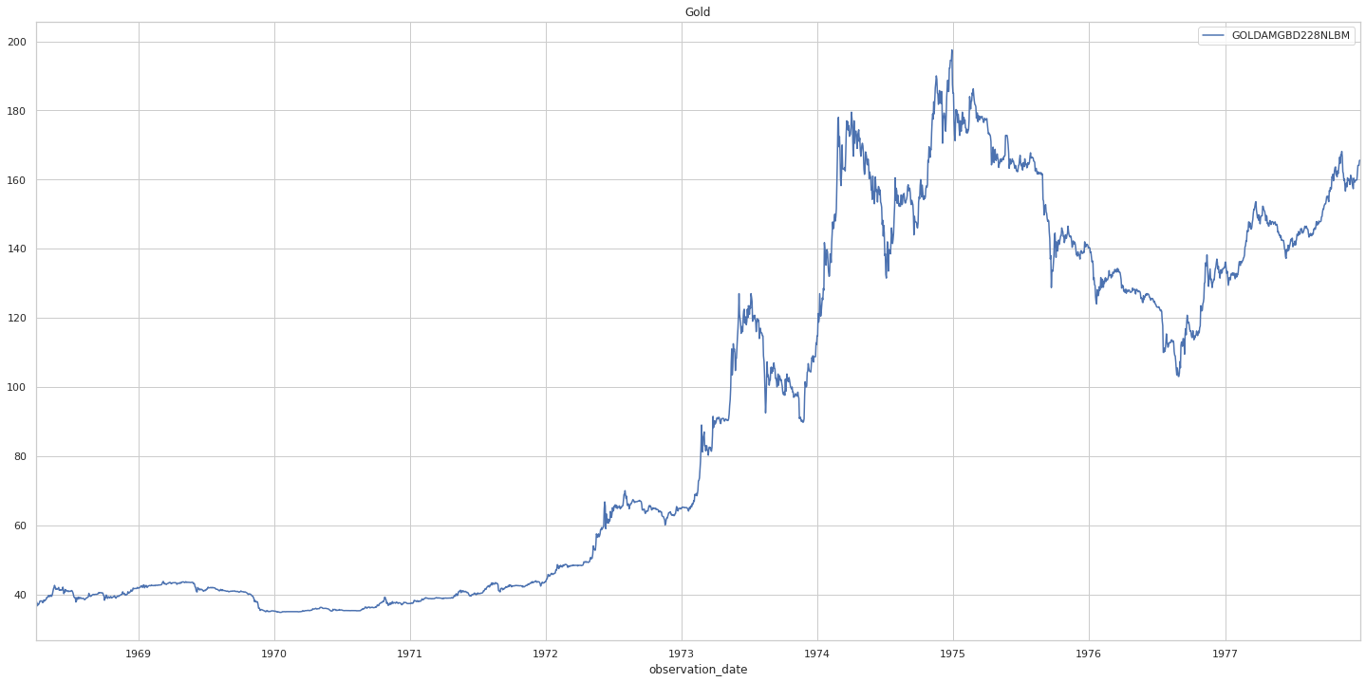
DECADE HISTORY OF GOLD
From - 1968 To 1977
SL No. | Max Price-$ | Year | Min Price -$ | Year
1 | 197.5 | 1974-12-30 | 34.775 | 1970-1-16
In 1973 for the first time gold price broke the $100 barrier.

Slide 12
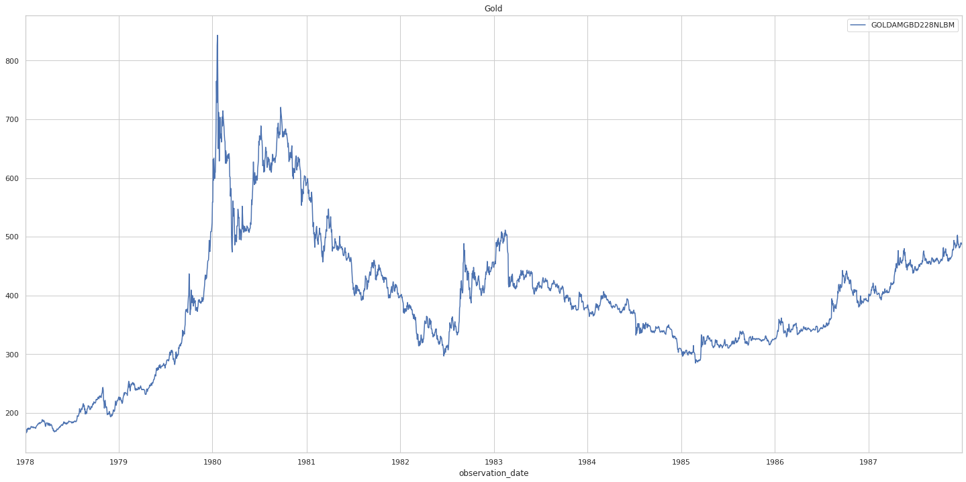
DECADE HISTORY OF GOLD
From 1978 To 1987
SL No. | Max Price-$ | Year | Min Price -$ | Year
1 | 843 | 1980-1-21 | 166.3 | 1978-1-5
1. In January 1980- gold hits a high record of $850 an ounce.
2.Reason for gold price increase- Bretton woods system dissolved by us president Nixon.
as investors pile into bullion promoted by high inflation due to strong oil prices.

Slide 13
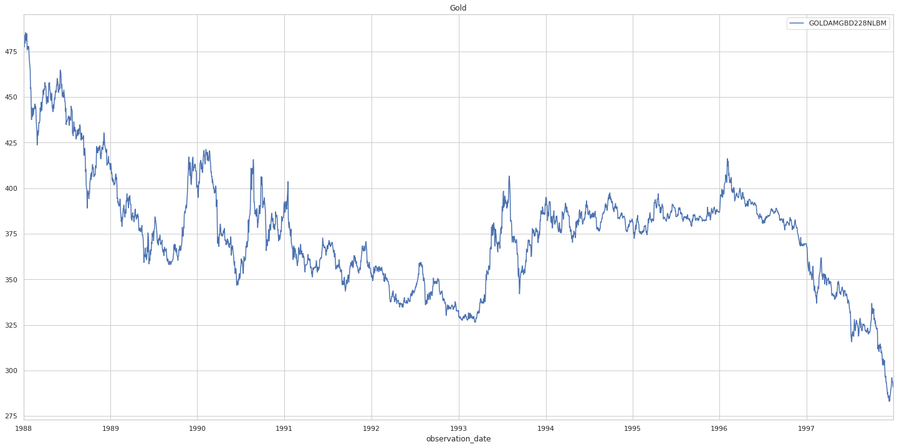
DECADE HISTORY OF GOLD
From 1988 To 1997
SL No. | Max Price-$ | Year | Min Price -$ | Year
1 | 485.3 | 1988-1-11 | 280.05 | 1977-12-12
reason for gold price increase correction period it was more like a one way down south for gold , after experiencing the gold price in January of 1980 by January 1990 gold price was trading around $400 per ounce.

Slide 14
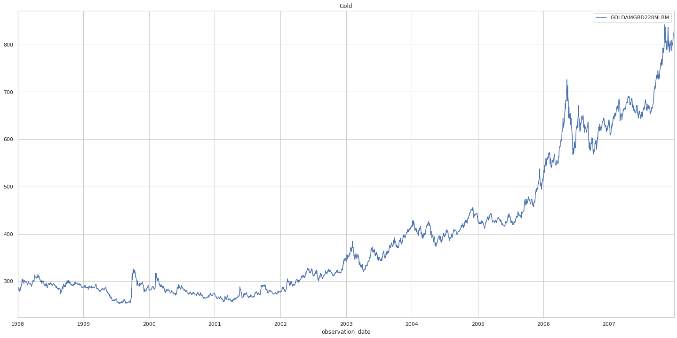
DECADE HISTORY OF GOLD
From 1998 To 2007
SL No. | Max Price-$ | Year | Min Price -$ | Year
1 | 841.75 | 2007-1-21 | 252.9 | 1999-1-5
1.reason for gold price increase in India is lack of supply and demand from India and china .
2. The start of recession times around the year of 2007 sparked substantial spikes in gold prices $841.

Slide 15
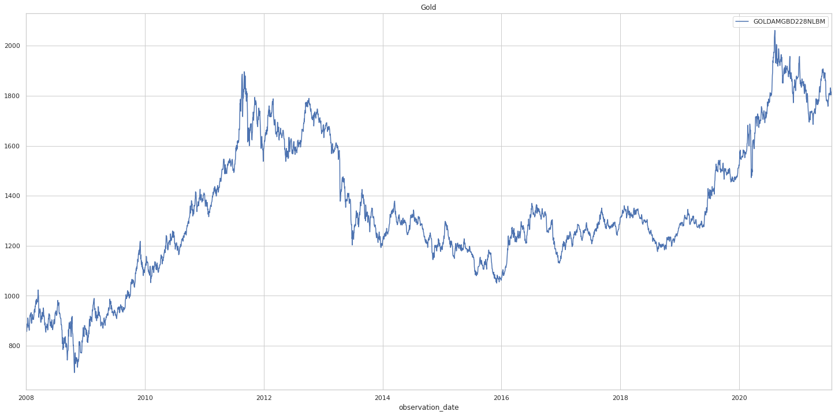
DECADE HISTORY OF GOLD
From 2007 To 2021
SL No. | Max Price-$ | Year | Min Price -$ | Year
1 | 2061.5 | 2020-8-7 | 692.5 | 2008-10-24
1.reason for gold price increase in this decade is due to COVID-19 pandemic.

Slide 16
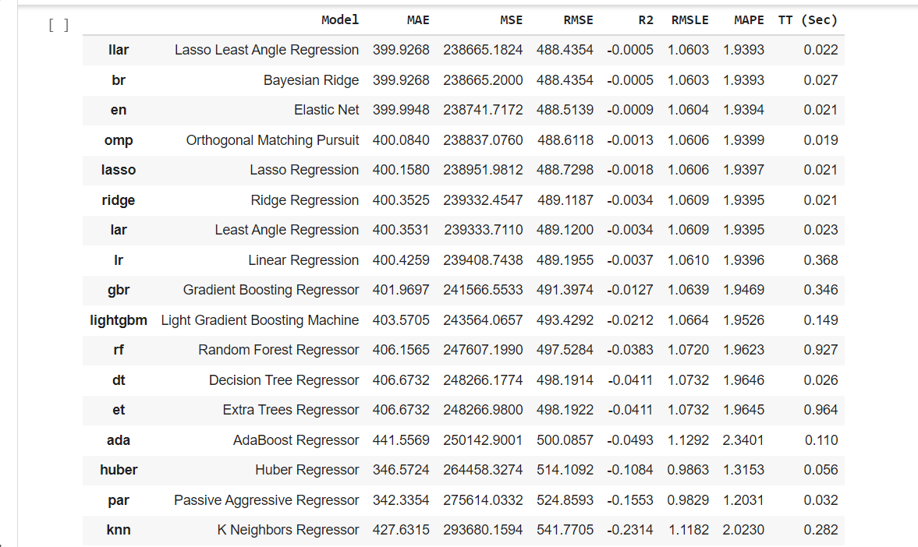
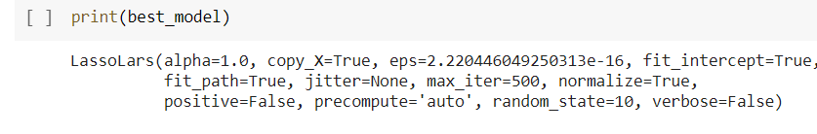
Pycaret Models
MODEL BUILDING
THE BEST MODEL FOR PyCaret is LASSO LEAST ANGLE REGRESSION.
THE RMSE VALUE FOR THE LASSO LEAST ANGLE REGRESSION IS 488.4354.

Slide 17
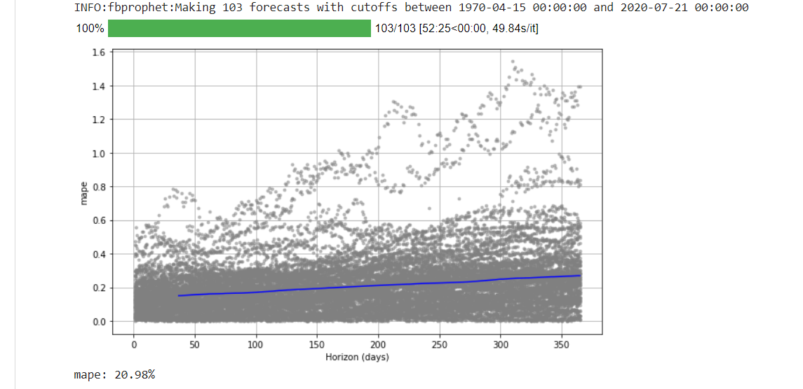
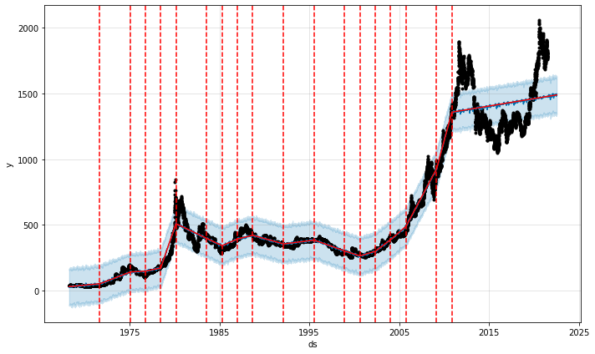
SATURATING GROWTH PLOT
FACEBOOK PROPHET MODEL
Notes:
RMSE-161

Slide 18
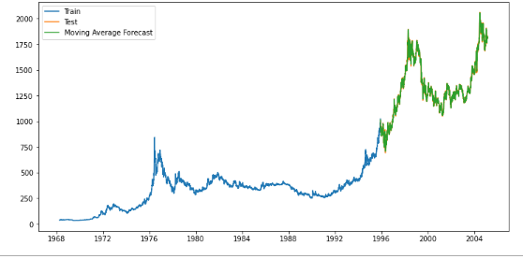
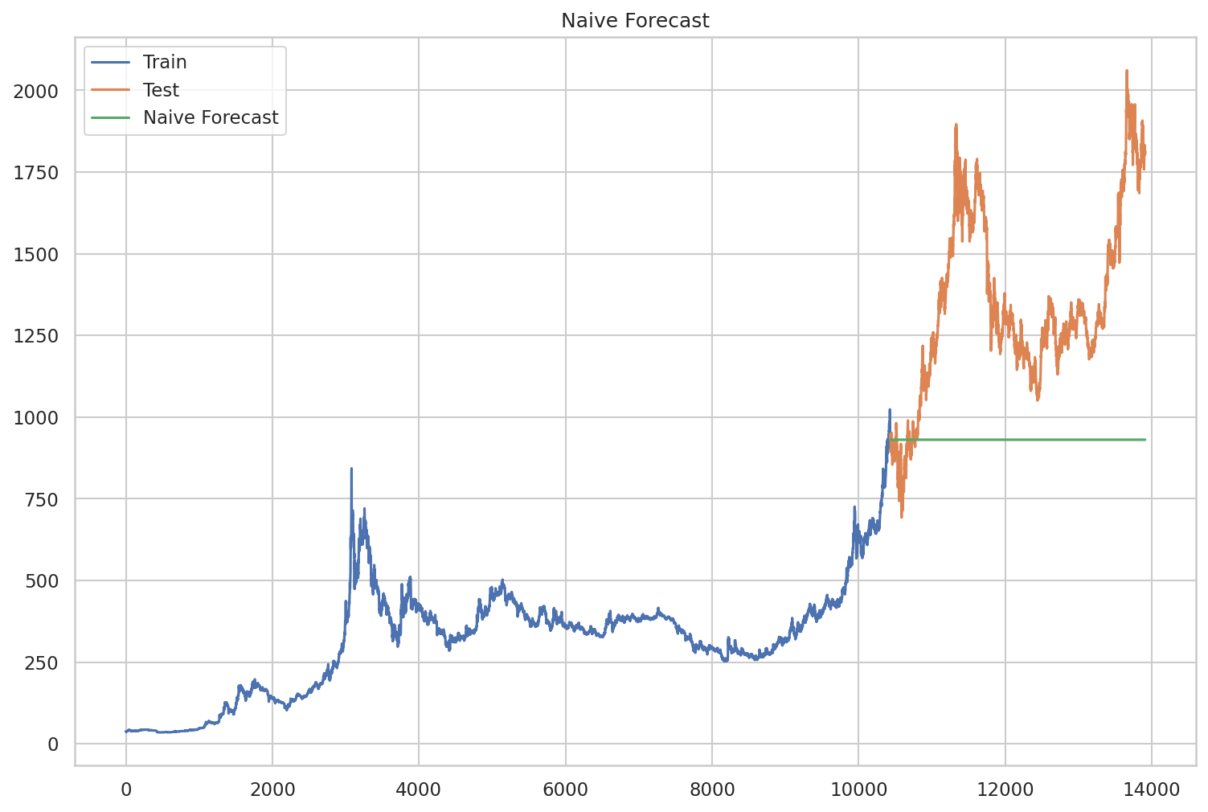
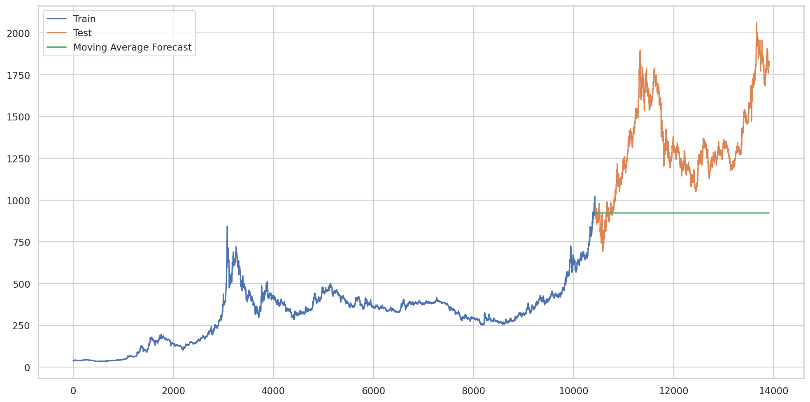
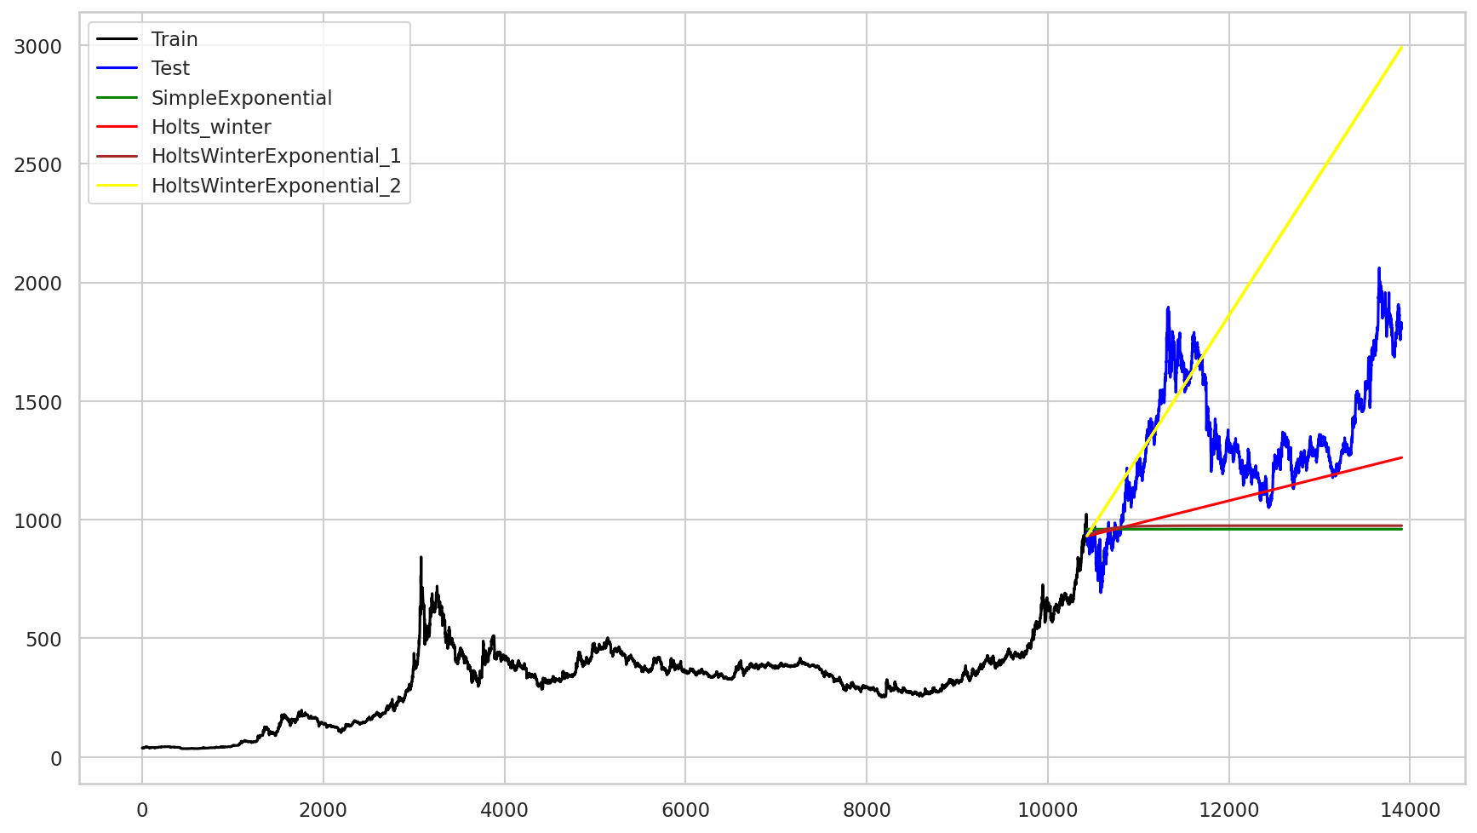
Moving Average
Naive Approach
SL No. | Model | RMSE
1 | Moving Average | 7.3
2 | Naive Approach | 492.06059219060774
Smoothing Techniques
SL No. | Model | RMSE
1 | Simple Exp Smoothing | 467.69759266157484
2 | Holt method | 342.08511058235996
3 | Holts winter exponential smoothing with additive seasonality and additive trend | 455.6318234698582
4 | Holts winter exponential smoothing with multiplicative seasonality and additive trend | 808.0328232207271

Slide 19
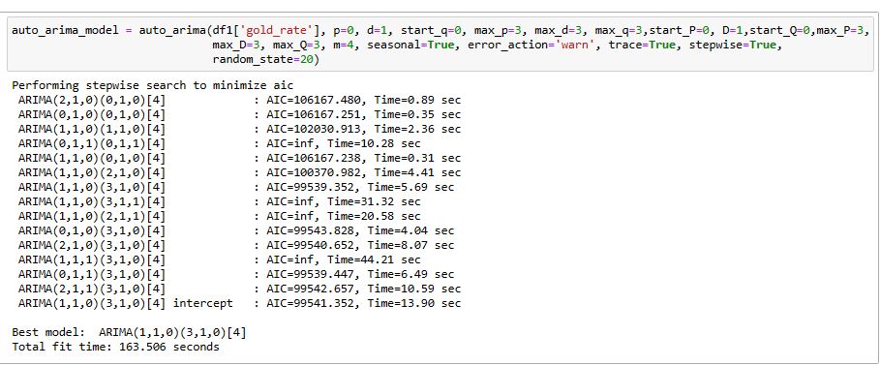
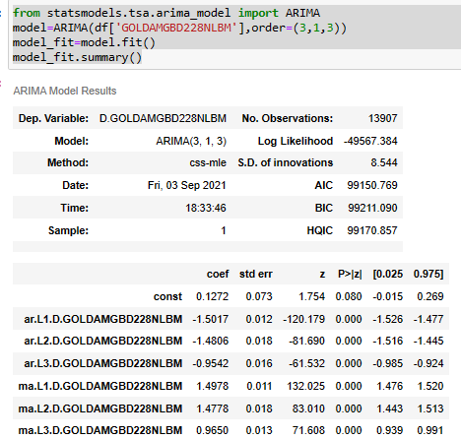
Auto ARIMA
ARIMA

Slide 20
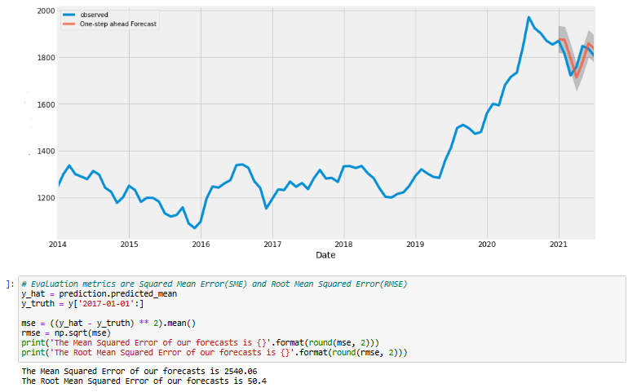
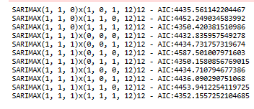
SARIMAX

Slide 21
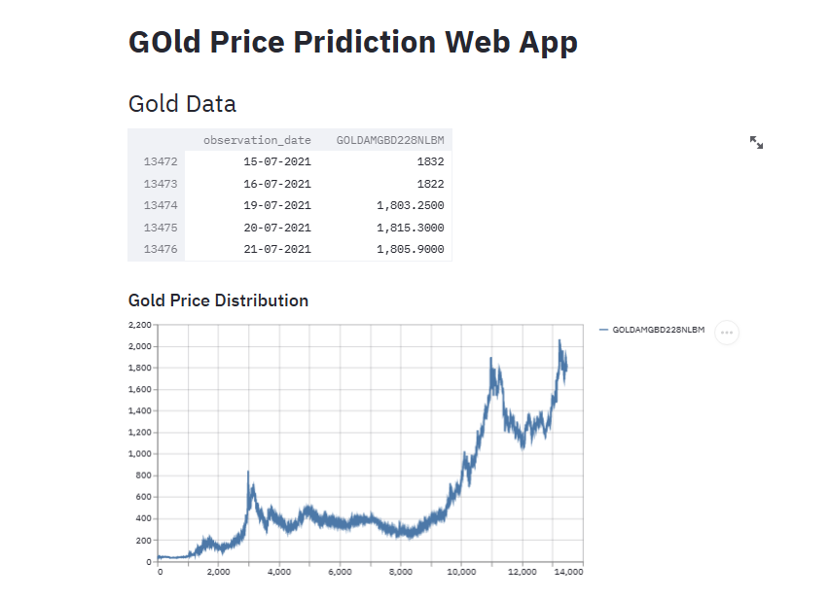
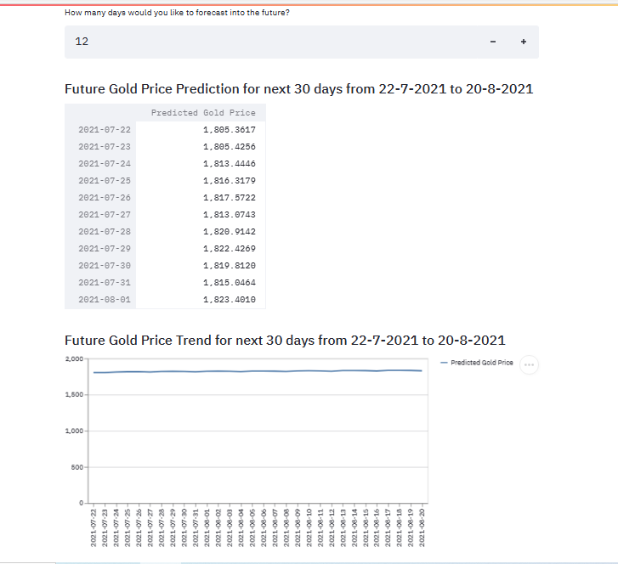
Project Deployment with Streamlit
Notes:
Above we can see that the gold price predicted for next 30 days from 22-7-2021 to 20-8-2021 lies between $1800-$1900

Slide 22
Gold as any other investment do not always guarantee a positive return Thank You

